Slide 1
Weekly Report
10/31/22
Erin Ingram & Omar Mahmood
NanoBio Systems Lab
Texas A&M University

Slide 2
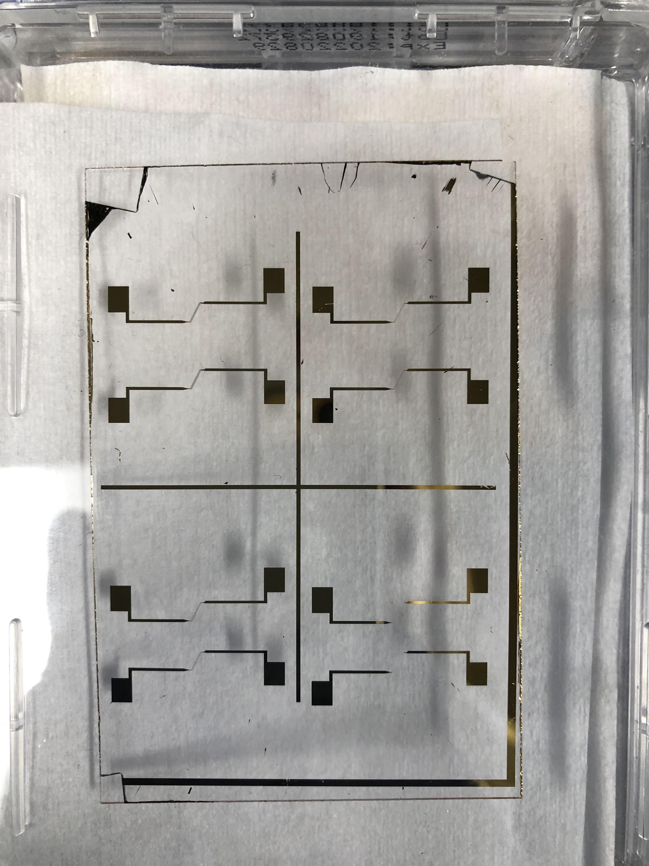
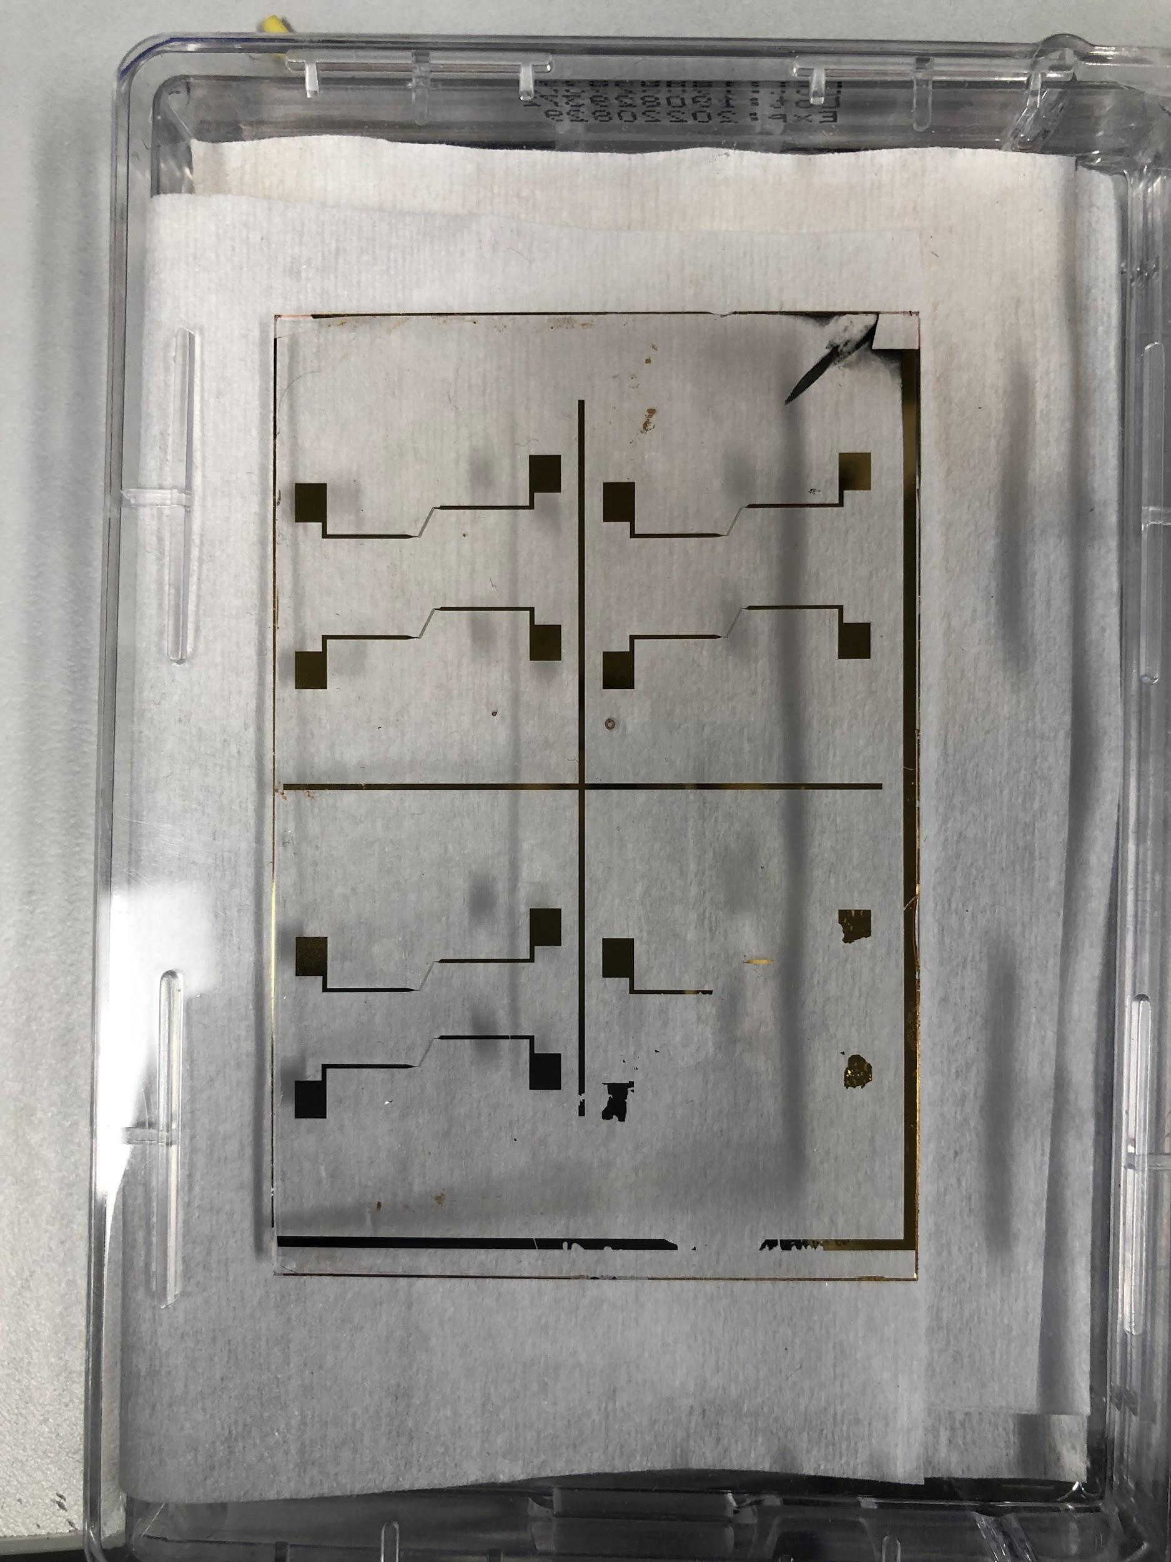
Progress
Trained on IDE fabrication techniques with our own IDE designs
Wet etching
Silicon nitride deposition using PECVD machine

Slide 3
Goals for next week
Bond PDMS chips to IDE slides using plasma cleaner
Train on alignment of IDE with physical filtration channel
Begin experiments using our device
Test droplet generation
Test filtration of satellite droplets

Slide 4
Thank you for your time!

